Slide 1

Model Context Protocol (MCP) Servers

Slide 2
Topics
Motivation
MCP Architecture
How it works
Benefits
Work in GENIE (Mentor Agent POC)
Autogen Core Integration
Challenges Faced + Overcome

Slide 3
Motivation
Attach context to models
Standard for LLM Applications to connect to and work with tools & data sources.
Removes need for custom API integration for tools
Notes:
# Topic: MCP Server for Notion Integration
## Presented By: Muhammad Umar
## Objective: Enable MCP to push/pull structured updates to Notion for documentation and task syncing.
## Approach: Built a REST-based MCP server that interfaces with Notion API using token-based auth; tested CRUD flows.
## Results: Successfully connected MCP to Notion workspace; updates from MCP now reflect in Notion pages.
## Limitations: Some rate limiting observed on Notion API; rich-text formatting inconsistencies.
## Next Steps: Add error handling, support for Notion database templates, and automate page linking to MCP modules.

Slide 4
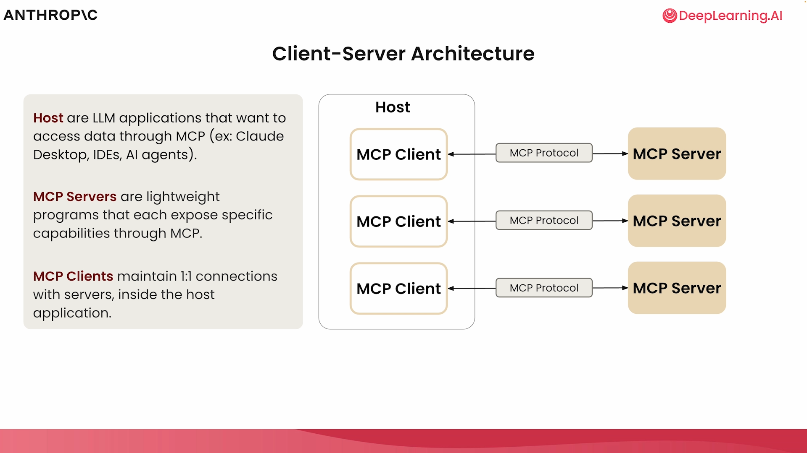
Architecture
Pipeline of agents.
Planner Agent: Interpret user query and generate a query plan
Refiner Agent: Optimize and validate the query plan
Query Agent: Execute the plan and retrieve the answer
Evaluation Agent: Evaluate and improve the final response
Notes:
# Topic: MCP Server for Notion Integration
## Presented By: Muhammad Umar
## Objective: Enable MCP to push/pull structured updates to Notion for documentation and task syncing.
## Approach: Built a REST-based MCP server that interfaces with Notion API using token-based auth; tested CRUD flows.
## Results: Successfully connected MCP to Notion workspace; updates from MCP now reflect in Notion pages.
## Limitations: Some rate limiting observed on Notion API; rich-text formatting inconsistencies.
## Next Steps: Add error handling, support for Notion database templates, and automate page linking to MCP modules.

Slide 5
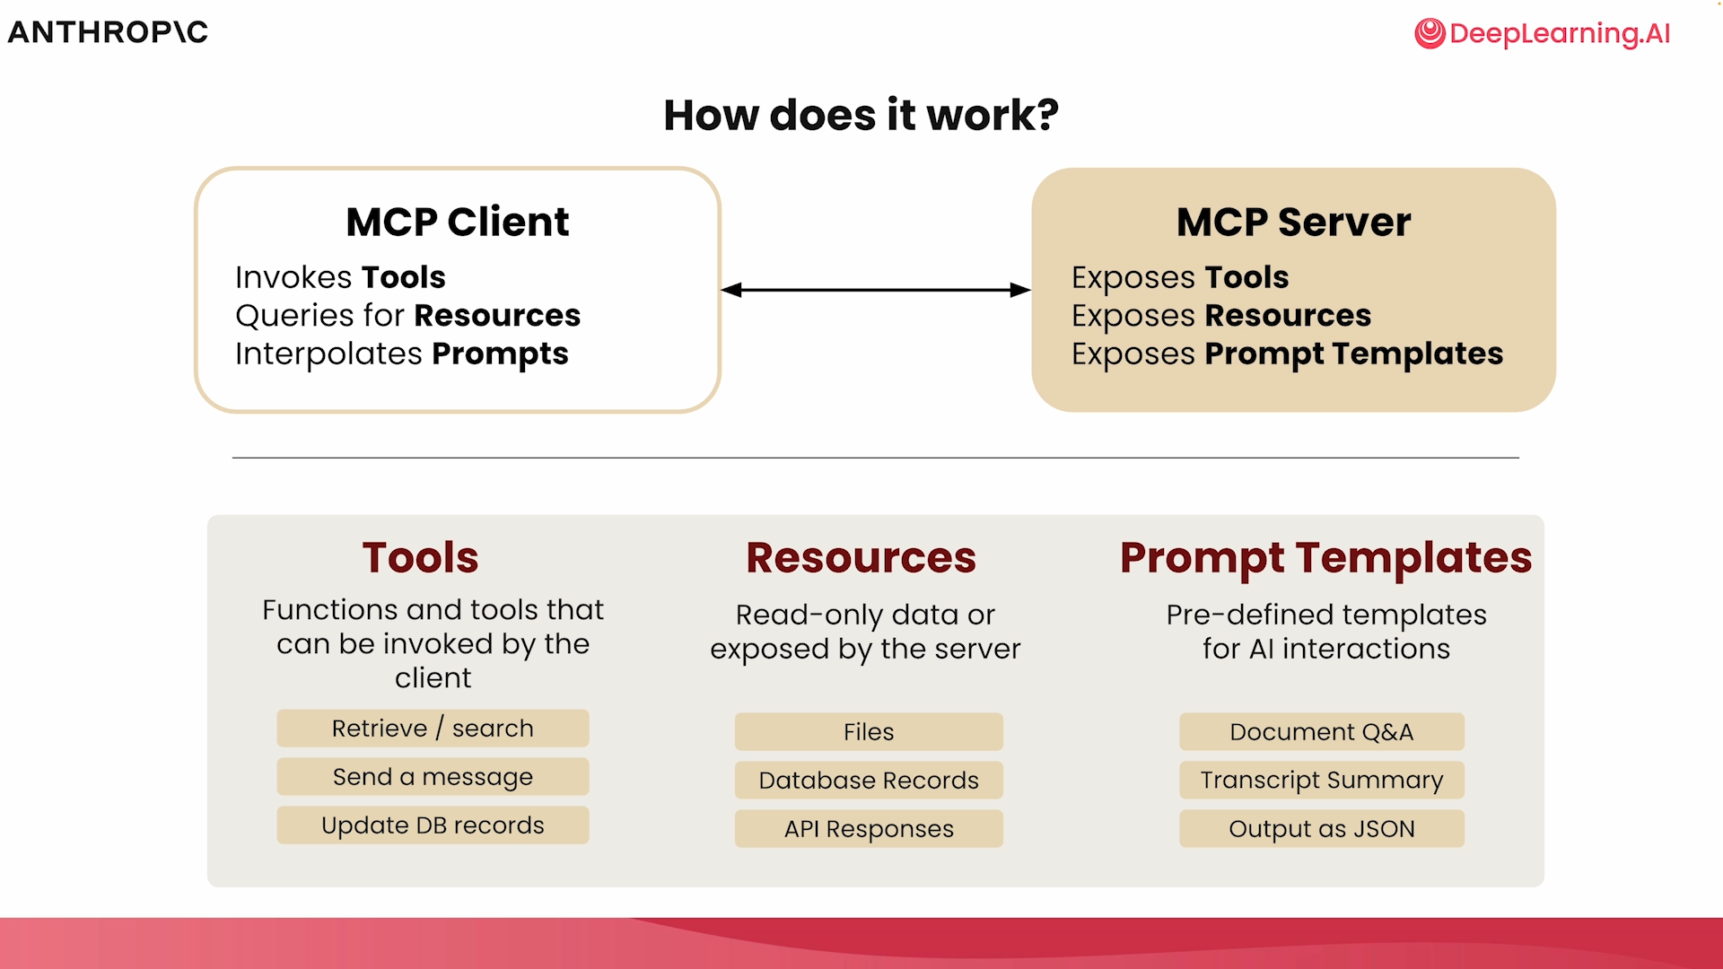
Architecture Diagram
Notes:
# Topic: MCP Server for Notion Integration
## Presented By: Muhammad Umar
## Objective: Enable MCP to push/pull structured updates to Notion for documentation and task syncing.
## Approach: Built a REST-based MCP server that interfaces with Notion API using token-based auth; tested CRUD flows.
## Results: Successfully connected MCP to Notion workspace; updates from MCP now reflect in Notion pages.
## Limitations: Some rate limiting observed on Notion API; rich-text formatting inconsistencies.
## Next Steps: Add error handling, support for Notion database templates, and automate page linking to MCP modules.

Slide 6
MCP Transports
STDIO (Standard Input/Output) - For servers running locally
HTTP + SSE (Server Sent Events) - For remote servers
Streamable HTTP

Slide 7
Benefits
Standardization & Interoperability
Enhanced model capabilities
Simplified development process
Context Preservation (Across multiple tools/servers)
Notes:
# Topic: MCP Server for Notion Integration
## Presented By: Muhammad Umar
## Objective: Enable MCP to push/pull structured updates to Notion for documentation and task syncing.
## Approach: Built a REST-based MCP server that interfaces with Notion API using token-based auth; tested CRUD flows.
## Results: Successfully connected MCP to Notion workspace; updates from MCP now reflect in Notion pages.
## Limitations: Some rate limiting observed on Notion API; rich-text formatting inconsistencies.
## Next Steps: Add error handling, support for Notion database templates, and automate page linking to MCP modules.

Slide 8
MCP Work in GENIE
Mentor Agent POC
Two servers, notion & Github
Integrated with agents
Dynamically used
Notes:
Trace Info State Management – Key Points
1Comprehensive Logging:
Each agent interaction generates a trace_info object capturing user input, agent inputs/outputs, timestamps, and processing times.
2Backend Persistence:
Trace info is stored in the database alongside each conversation turn, enabling robust audit trails and debugging.
3Frontend Transparency:
Trace info is sent to the UI with every response, allowing users to inspect agent reasoning and performance for each query.
4Session-Based History:
The UI maintains a per-chat trace_history, ensuring users can review the full decision process across their session.
5Persistent Storage:
All trace histories are saved to disk, supporting session recovery and long-term analysis.

Slide 9
MCP with Autogen Core
MCP Workbench is created - wraps an MCP server and provides an interface for agent to list and call tools provided by server.
Workbench is attached to an agent, giving it access to these tools
Agent uses the tools and query provided to form a response
Data fetched from these tools is attached as context to LLM (GPT-4o)

Slide 10
Challenges Faced so far
Official Notion Server Integration
Could not connect with Autogen Core, had to find alternate server
OS Dependencies
MCP Servers were not starting on windows
For stdio, client launches server as subprocess using asyncio, causing compatibility issues
Communication Protocol restrictions
Server did not support SSE
Had to use “supergateway”, which runs MCP stdio servers over SSE
Notes:
# Topic: MCP Server for Notion Integration
## Presented By: Muhammad Umar
## Objective: Enable MCP to push/pull structured updates to Notion for documentation and task syncing.
## Approach: Built a REST-based MCP server that interfaces with Notion API using token-based auth; tested CRUD flows.
## Results: Successfully connected MCP to Notion workspace; updates from MCP now reflect in Notion pages.
## Limitations: Some rate limiting observed on Notion API; rich-text formatting inconsistencies.
## Next Steps: Add error handling, support for Notion database templates, and automate page linking to MCP modules.

